Slide 1

Smarter Solutions to fight COVID-19
Presented By
ANKITA KHAN (1SG16IS011) BRIJESH KUMAR (1SG16IS020)

Slide 2

CONTENTS
Topic
Technologies Used
Explanation of the project
Uniqueness
Implementation Details
Benefits to the society
Snapshots
References

Slide 3

TOPIC
Real Time Covid-19 World Tracker with Live Chatbot
It tracks number of active cases, recoveries and deaths globally.
It also gives the count for all the countries across the globe.
It give graphical representations for the counts.
A live chatbot to solve common human queries.

Slide 4


TECHNOLOGIES USED
React JS
Material UI
API Data Fetching
Charts.js and React Hooks
HTML
CSS
JavaScript
JavaScript API
Wordpress plugins

Slide 5

PROJECT EXPLAINATION
The real time COVID-19 world tracker tracks the count of three quantities:
Number of active cases
Number of recoveries
Number of deaths
It considers two cases:
Case 1:
For global, the counts are shown as well as the line graph is plotted for pictorial representations.
Case 2:
For specific country, the counts are shown as well as the bar graphs are plotted for pictorial representations.

Slide 6

The tracker also has a chatbot called “COVID-19 Sahaya” which helps answering common human questionnaires.
The chatbot provides help in the following areas:
Protect Yourself : Symptoms
Precautions
Physical Health
Mental Health
News and Press
Travel Advice : Carry these essentials
Covid-19 Hacks
Not Feeling Well?
Donate Now

Slide 7

UNIQUENESS
It does not takes any user details to use the application.
Privacy of user is maintained.
It is user-friendly.
It provides valuable information related to the pandemic.
It updates the user with useful prevention techniques.
It also provides the user with news, healthcare tips and hacks all in one place.
It also notifies the user with the symptoms and provides contact details for covid-19 emergencies.
It also provides details where people can help the needy for the noble cause.

Slide 8
IMPLEMENTATION DETAILS
The global tracker application named “Corona Virus Tracker” is developed using React Hooks, Material UI, Charts.js, API data fetching, all of it in React JS.
The web application is developed using additional languages such as HTML, CSS, JS and JS API’s.
The tracker mainly gives numerical and pictorial representations of the number of active cases, recoveries and deaths from the global pandemic “Coronavirus”.
Using plugins, the chatbot is attached to the global tracker.
The chatbot named “COVID-19 Sahaya” is a user friendly app with numerous features such as Protect Yourself : Symptoms, Precautions, Physical Health, Mental Health, News and Press, Travel Advice : Carry these essentials, Covid-19 Hacks, Not Feeling Well? and Donate Now.

Slide 9


BENEFITS TO THE SOCIETY
Updates the user with correct information regarding the protection measures.
Provides measures for physical and mental health all in a single place.
Contains News and Press for daily updates.
Provides travel advice.
Teaches life saving hacks to fight against Covid-19.
Provides contact details for pandemic related emergencies.
Contributions can also be made for the world through this application.

Slide 10

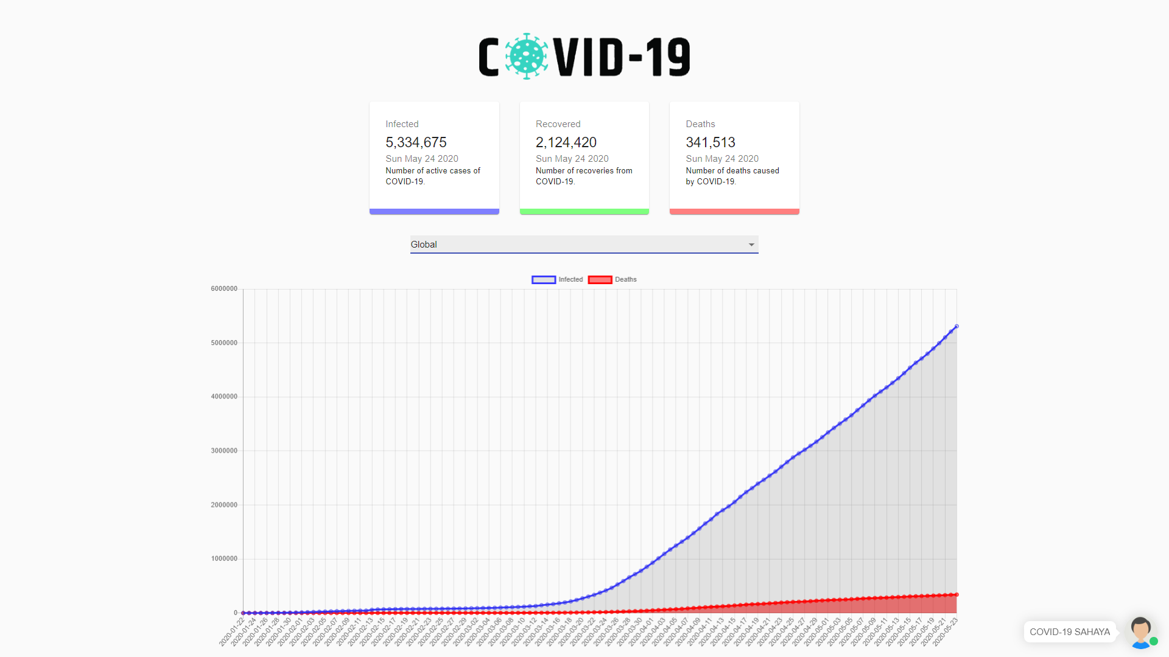
SNAPSHOTS
Global COVID-19 Tracker with current counts of active cases, recoveries and deaths along with “COVID-19 Sahaya” chatbot

Slide 11

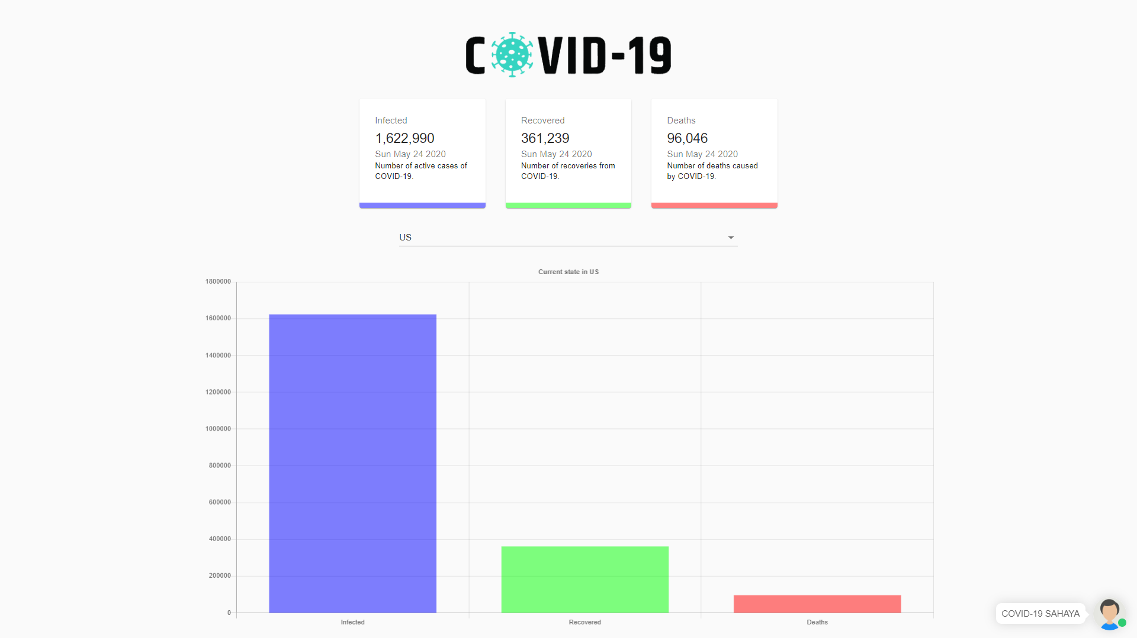
COVID-19 Tracker for US (selected country) with current counts of active cases, recoveries and deaths along with “COVID-19 Sahaya” chatbot

Slide 12
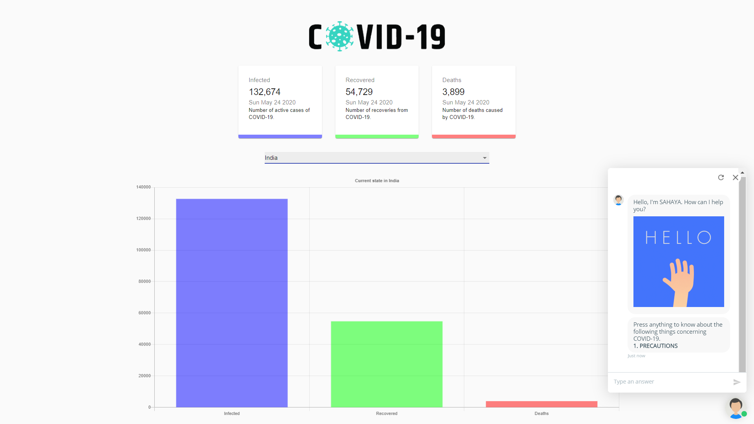
COVID-19 Tracker for India (selected country) with current counts of active cases, recoveries and deaths along with “COVID-19 Sahaya” chatbot

Slide 13
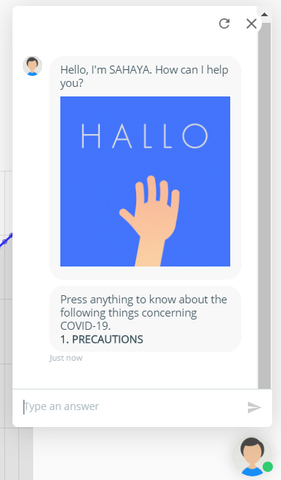
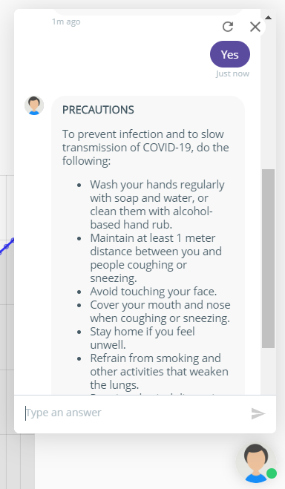
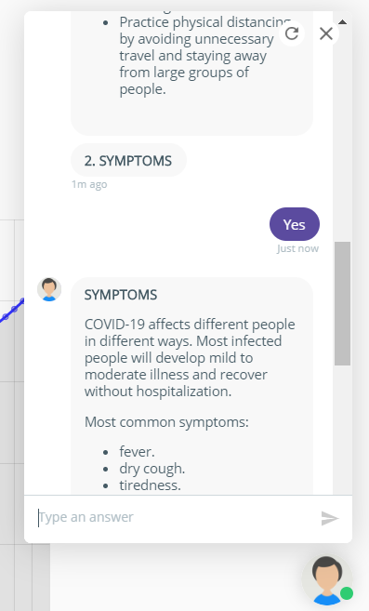
The following snapshots shows the functionalities of the user-friendly chatbot of the tracker application named
“COVID-19 Sahaya”

Slide 14
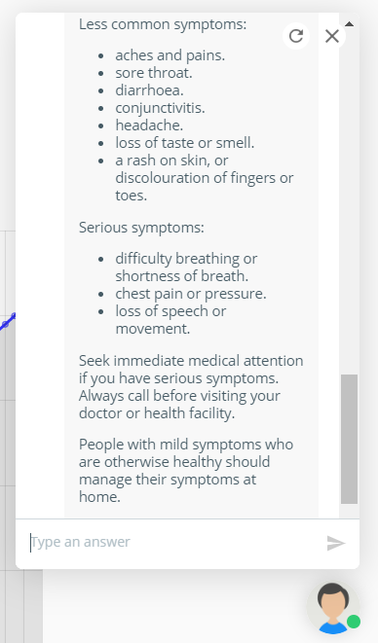
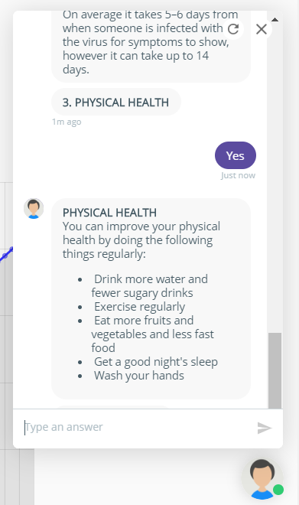
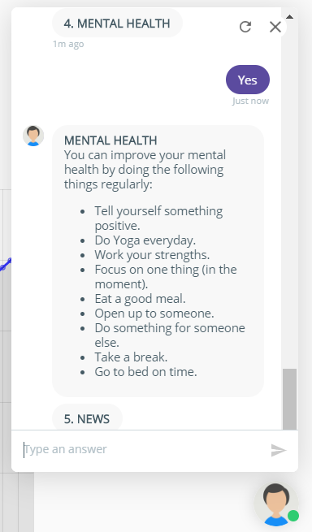

Slide 15
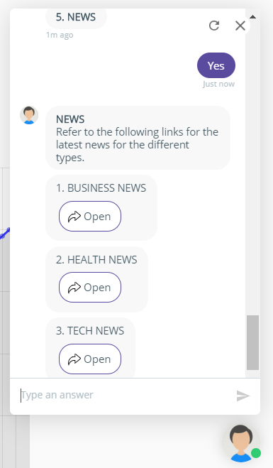
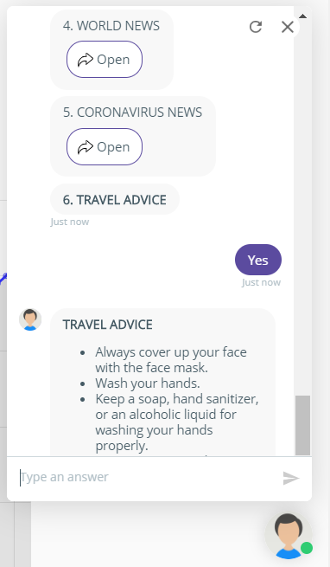
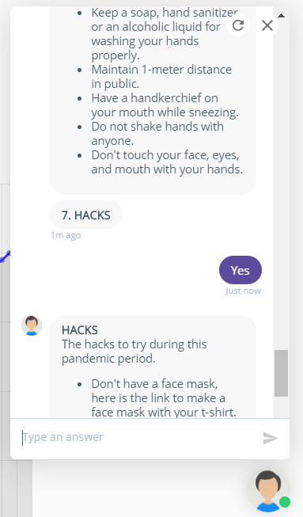

Slide 16
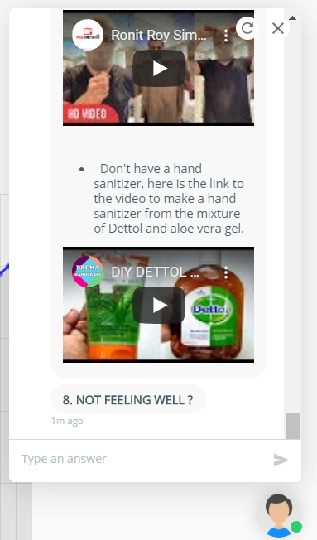
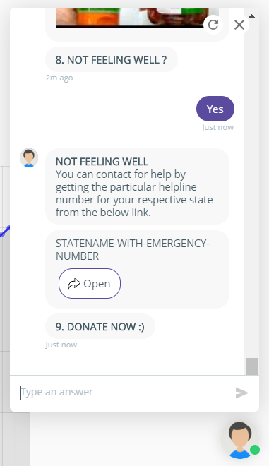
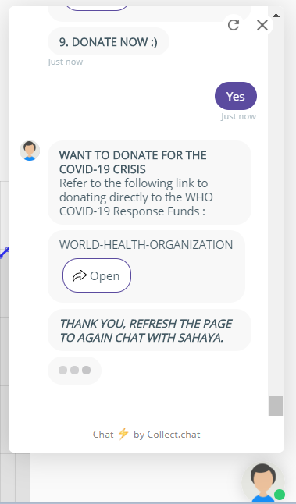

Slide 17




REFERENCES
www.google.com
www.who.int
https://covid19.mathdro.id/api
https://collect.chat/
https://www.w3schools.com/

Slide 18
THANK you

